Slide 1
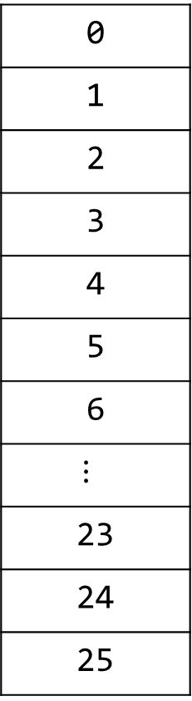
0
1
2
3
4
5
6
$$⋮$$
23
24
25
All Possible Surnames
Abid
Ashe
Blacksill
Used
Surnames
Gough
Zhang
Zorg

Slide 2
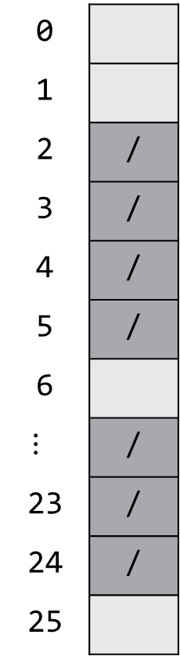
0
1
2 | /
3 | /
4 | /
5 | /
6
$$⋮$$ | /
23 | /
24 | /
25
All Possible Surnames
Abid
Ashe
Blacksill
Used
Surnames
Gough
Zhang
Zorg

Slide 3
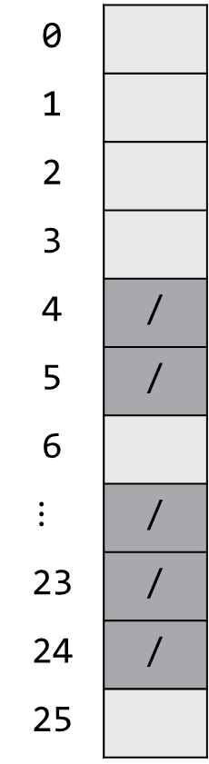
0
1
2
3
4 | /
5 | /
6
$$⋮$$ | /
23 | /
24 | /
25
All Possible Surnames
Abid
Ashe
Blacksill
Used
Surnames
Gough
Zhang
Zorg

Slide 4
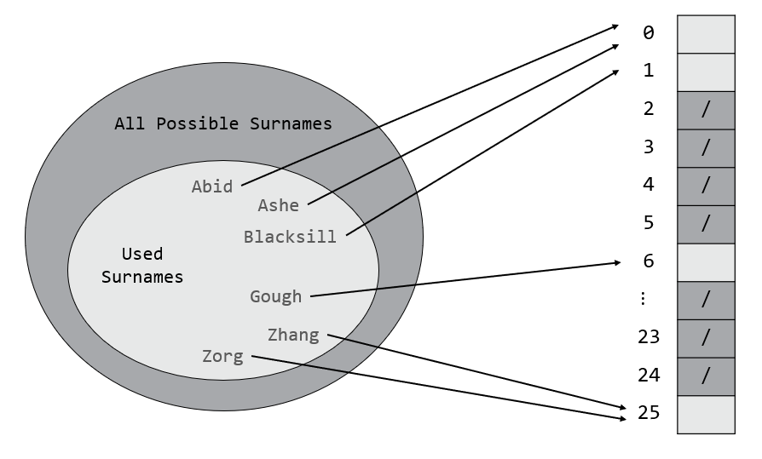
/ | Abid
 | Ashe | /
/ | Blacksill
/ | Gough | /
/ | Zorg
 | Zhang | /

Slide 5
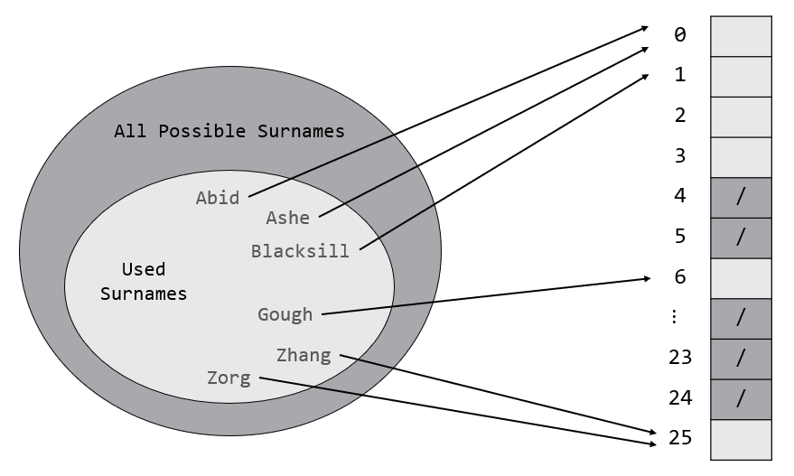
Ashe | Data
Blacksill | Data
Zorg | Data
Abid | Data
Gough | Data
Zhang | Data
Order of entry: Ashe, Blacksill, Gough Zhang, Zorg, Abid

Slide 6
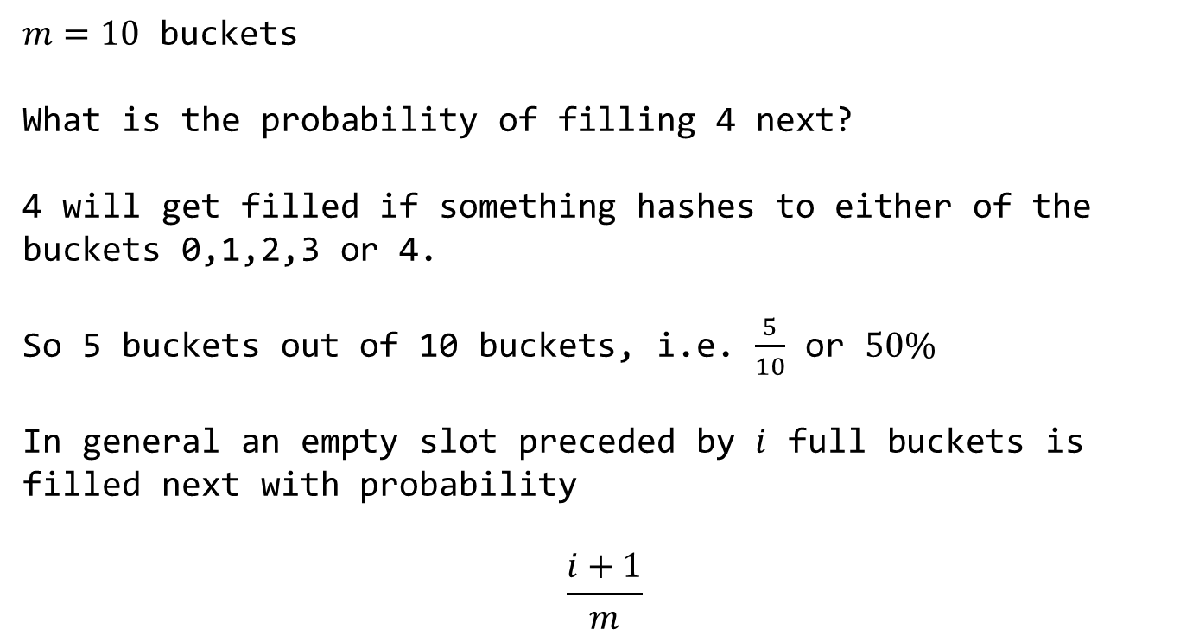
0
1
2
3
4 | /
5 | /
6
7 | /
8 | /
9 | /
$m=10$ buckets
What is the probability of filling 4 next?
4 will get filled if something hashes to either of the buckets 0,1,2,3 or 4.
So 5 buckets out of 10 buckets, i.e. $\frac{5}{10}$ or $50\%$
In general an empty slot preceded by $i$ full buckets is filled next with probability
$$\frac{i+1}{m}$$

Slide 7
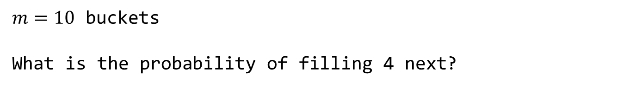
0
1
2
3
4 | /
5 | /
6
7 | /
8 | /
9 | /
$m=10$ buckets
What is the probability of filling 4 next?

